Slide 1
MERGING AND REVERSING OF ARRAYS
DEPARTMENT OF ELECTRONIC AND COMMUNICATION
INDIAN INSTITUTE OF INFORMATION TECHNOLOGY, ALLAHABAD
Created by :
SUDHA YADAV ( IEC2021075)
SAHIL YADAV (IEC2021076)
RIDDHI KEDIA (IEC2021077)
SHIVAM KUMAR SINGH (IEC2021078)
Guided by:
MD. MERAZ SIR
Professor:
DR. MOHAMMED JAVED SIR

Slide 2
CONTENTS :
INTRODUCTION
PROBLEM STATEMENT
ALGORITHM
CODE
CONCLUSION
ACKNOWLEDGEMENT
REFERENCES

Slide 3
INTRODUCTION
An array is defined as the collection of similar type of data items stored at continuous memory locations. It is the simplest data structure where each element can be randomly accessed by using its index number.
Merging of two arrays means combining two arrays into one single array. Given two arrays, if a[] contains p elements and b[] contains q elements then the merging of these two arrays will produce a third array c[] which will contain (p+q) elements. The final merged array is formed by writing the elements of the first array and then writing the elements of the second array.
When the elements of the third array c[] are written in reverse order to its original format then the process is called to be reversing of the array. Sometimes this process is required by programmers to publish data in reverse order, therefore it becomes quite useful.

Slide 4

PROBLEM STATEMENT
Given two arrays a[] and b[], we are required to merge these two arrays into the third array c[] and then reverse the third array c[] by using C programming language.

Slide 5
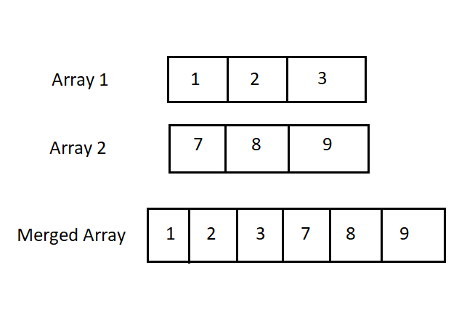
MERGING OF 2 ARRAYS
REVERSING OF ARRAY

Slide 6
ALGORITHM
First, we would include a header file named stdio.h so that the compiler gets to know about the keywords used to code the programme. Then after using the main function, we would declare the variables p, q, r and i using the int function.
After that, we would ask the user about the no. of elements (p) in first array which is basically the array size declaration process. Then the declaration of array is done by using int a[p]. Similarly for the second array the size would be q and array will be written as b[q] and the third array will be c[r], where r=p+q.
We will take inputs of array elements from the user by using scanf statements and this process of taking inputs will be done by using for loop. Inside the for loop, we will be mentioning (initialization; condition; change).

Slide 7
Now we start the for loop in which we assign i=0 as initialisation, i<=p-1 as condition and i++ for increasing the value of i each time inside the loop. Scanf function will use %d as format specifier and address of a[i]. Similarly for the second array, the above mentioned process will be executed where, i<=q-1 and &b[i] will be used.
Now for finding the third array c[r], we will have to merge a[p] and b[q]. We will apply for loop by assigning i=0, with condition i<=p-1 and by increasing i by 1 everytime. Then we equate c[i] = a[i]. Now again apply loop for i<=q-1 and c[i+x] =b[i]. Now again applying loop for i=o and i<=z-1 and increasing the value of i by 1 each time it is printing the elements of array c[r].
Now for finding the reverse of c[r] array, we will apply the for loop by assigning i=z-1 with condition i>=0 and decreasing the value of i by 1 (i--) every time in the loop. Hence the array will be printed in reverse order. Therefore, by these steps we have completed our program which is now ready to compile and run.

Slide 8
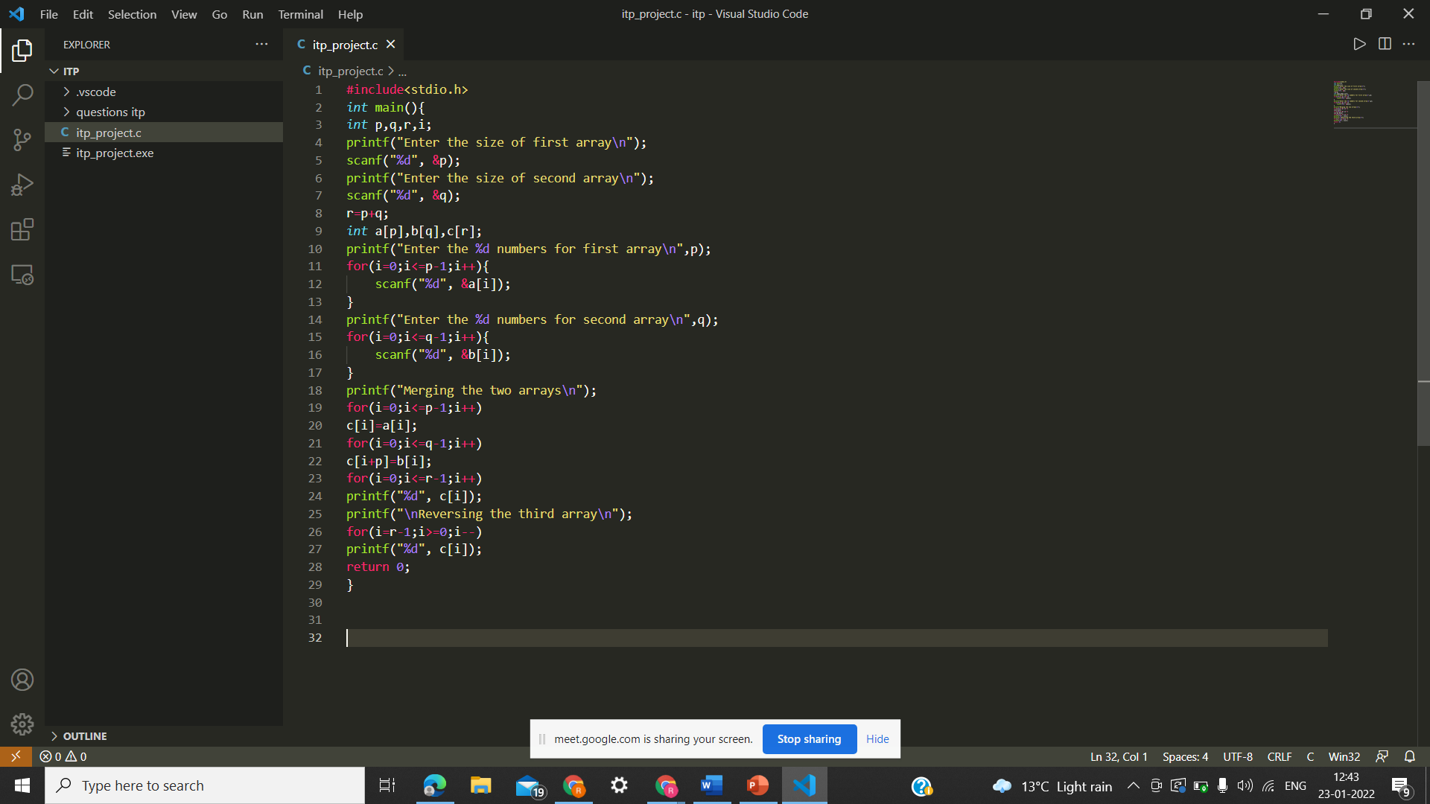
CODE USED FOR PROGRAMMING

Slide 9
CONCLUSION
In order to solve the given problem, we made a program to merge any two arrays. Size of arrays and their elements are being decided and entered by the user. There after we have used for loops to merge the two arrays into the third array, and then finally reverse the third array. As an output the merged array and the reversed array are printed on the output screen.

Slide 10
ACKNOWLEDGEMENT
All the members of our team would like to express our special thanks to our respected Professor Dr. Mohammed Javed Sir and our Teaching Assistant Mr. Md. Meraz Sir and Ms. Tejasvee Bisen Mam for giving us this learning opportunity through this assignment which helped us to get more familiar with the concepts of array.
REFERENCES
https://www.geeksforgeeks.org
https://www.codescracker.com

